Slide 1
CSE 319 Software Engineering
Lecture : Project planning
Anisur Rahman
Military Institute of Science and Technology

Slide 2
Topics covered
Software pricing
Plan-driven development
Project scheduling
Agile planning
Estimation techniques

Slide 3
Project planning
Project planning involves breaking down the work into parts and assign these to project team members, anticipate problems that might arise and prepare tentative solutions to those problems.
The project plan, which is created at the start of a project, is used to communicate how the work will be done to the project team and customers, and to help assess progress on the project.

Slide 4
Planning stages
At the proposal stage, when you are bidding for a contract to develop or provide a software system.
During the project startup phase, when you have to plan who will work on the project, how the project will be broken down into increments, how resources will be allocated across your company, etc.
Periodically throughout the project, when you modify your plan in the light of experience gained and information from monitoring the progress of the work.

Slide 5
Proposal planning
Planning may be necessary with only outline software requirements.
The aim of planning at this stage is to provide information that will be used in setting a price for the system to customers.

Slide 6
Software pricing
Estimates are made to discover the cost, to the developer, of producing a software system.
You take into account, hardware, software, travel, training and effort costs.
There is not a simple relationship between the development cost and the price charged to the customer.
Broader organisational, economic, political and business considerations influence the price charged.

Slide 7
Factors affecting software pricing
Factor | Description
Market opportunity | A development organization may quote a low price because it wishes to move into a new segment of the software market. Accepting a low profit on one project may give the organization the opportunity to make a greater profit later. The experience gained may also help it develop new products.
Cost estimate uncertainty | If an organization is unsure of its cost estimate, it may increase its price by a contingency over and above its normal profit.
Contractual terms | A customer may be willing to allow the developer to retain ownership of the source code and reuse it in other projects. The price charged may then be less than if the software source code is handed over to the customer.

Slide 8
Factors affecting software pricing
Factor | Description
Requirements volatility | If the requirements are likely to change, an organization may lower its price to win a contract. After the contract is awarded, high prices can be charged for changes to the requirements.
Financial health | Developers in financial difficulty may lower their price to gain a contract. It is better to make a smaller than normal profit or break even than to go out of business. Cash flow is more important than profit in difficult economic times.

Slide 9
Plan-driven development
Plan-driven or plan-based development is an approach to software engineering where the development process is planned in detail.
Plan-driven development is based on engineering project management techniques and is the ‘traditional’ way of managing large software development projects.
A project plan is created that records the work to be done, who will do it, the development schedule and the work products.
Managers use the plan to support project decision making and as a way of measuring progress.

Slide 10
Plan-driven development – pros and cons
The arguments in favor of a plan-driven approach are that early planning allows organizational issues (availability of staff, other projects, etc.) to be closely taken into account, and that potential problems and dependencies are discovered before the project starts, rather than once the project is underway.
The principal argument against plan-driven development is that many early decisions have to be revised because of changes to the environment in which the software is to be developed and used.

Slide 11
Project plans
In a plan-driven development project, a project plan sets out the resources available to the project, the work breakdown and a schedule for carrying out the work.
Plan sections
Introduction
Project organization
Risk analysis
Hardware and software resource requirements
Work breakdown
Project schedule
Monitoring and reporting mechanisms

Slide 12
Project plan supplements
Plan | Description
Quality plan | Describes the quality procedures and standards that will be used in a project.
Validation plan | Describes the approach, resources, and schedule used for system validation.
Configuration management plan | Describes the configuration management procedures and structures to be used.
Maintenance plan | Predicts the maintenance requirements, costs, and effort.
Staff development plan | Describes how the skills and experience of the project team members will be developed.

Slide 13
The planning process
Project planning is an iterative process that starts when you create an initial project plan during the project startup phase.
Plan changes are inevitable.
As more information about the system and the project team becomes available during the project, you should regularly revise the plan to reflect requirements, schedule and risk changes.
Changing business goals also leads to changes in project plans. As business goals change, this could affect all projects, which may then have to be re-planned.

Slide 14
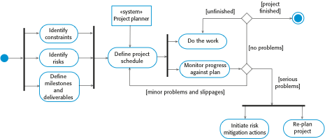
The project planning process

Slide 15
Project scheduling
Project scheduling is the process of deciding how the work in a project will be organized as separate tasks, and when and how these tasks will be executed.
You estimate the calendar time needed to complete each task, the effort required and who will work on the tasks that have been identified.
You also have to estimate the resources needed to complete each task, such as the disk space required on a server, the time required on specialized hardware, such as a simulator, and what the travel budget will be.

Slide 16
Project scheduling activities
Split project into tasks and estimate time and resources required to complete each task.
Organize tasks concurrently to make optimal use of workforce.
Minimize task dependencies to avoid delays caused by one task waiting for another to complete.
Dependent on project managers intuition and experience.

Slide 17
Milestones and deliverables
Milestones are points in the schedule against which you can assess progress, for example, the handover of the system for testing.
Deliverables are work products that are delivered to the customer, e.g. a requirements document for the system.

Slide 18

The project scheduling process

Slide 19
Scheduling problems
Estimating the difficulty of problems and hence the cost of developing a solution is hard.
Productivity is not proportional to the number of people working on a task.
Adding people to a late project makes it later because of communication overheads.
The unexpected always happens. Always allow contingency in planning.

Slide 20
Schedule representation
Graphical notations are normally used to illustrate the project schedule.
These show the project breakdown into tasks. Tasks should not be too small. They should take about a week or two.
Bar charts are the most commonly used representation for project schedules. They show the schedule as activities or resources against time.

Slide 21
Tasks, durations, and dependencies
Task | Effort (person-days) | Duration (days) | Dependencies
T1 | 15 | 10
T2 | 8 | 15
T3 | 20 | 15 | T1 (M1)
T4 | 5 | 10
T5 | 5 | 10 | T2, T4 (M3)
T6 | 10 | 5 | T1, T2 (M4)
T7 | 25 | 20 | T1 (M1)
T8 | 75 | 25 | T4 (M2)
T9 | 10 | 15 | T3, T6 (M5)
T10 | 20 | 15 | T7, T8 (M6)
T11 | 10 | 10 | T9 (M7)
T12 | 20 | 10 | T10, T11 (M8)

Slide 22
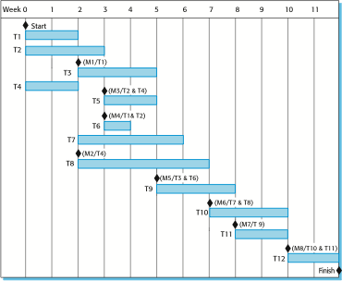
Activity bar chart

Slide 23
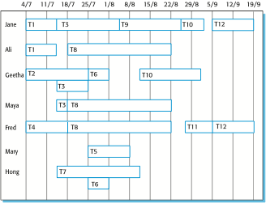
Staff allocation chart

Slide 24
Agile planning
Agile methods of software development are iterative approaches where the software is developed and delivered to customers in increments.
Unlike plan-driven approaches, the functionality of these increments is not planned in advance but is decided during the development.
The decision on what to include in an increment depends on progress and on the customer’s priorities.
The customer’s priorities and requirements change so it makes sense to have a flexible plan that can accommodate these changes.

Slide 25
Agile planning stages
Release planning, which looks ahead for several months and decides on the features that should be included in a release of a system.
Iteration planning, which has a shorter term outlook, and focuses on planning the next increment of a system. This is typically 2-4 weeks of work for the team.

Slide 26

Planning in XP

Slide 27
Story-based planning
The system specification in XP is based on user stories that reflect the features that should be included in the system.
The project team read and discuss the stories and rank them in order of the amount of time they think it will take to implement the story.
Release planning involves selecting and refining the stories that will reflect the features to be implemented in a release of a system and the order in which the stories should be implemented.
Stories to be implemented in each iteration are chosen, with the number of stories reflecting the time to deliver an iteration (usually 2 or 3 weeks).

Slide 28
Key points
The price charged for a system does not just depend on its estimated development costs; it may be adjusted depending on the market and organizational priorities.
Plan-driven development is organized around a complete project plan that defines the project activities, the planned effort, the activity schedule and who is responsible for each activity.
Project scheduling involves the creation of graphical representations the project plan. Bar chartsshow the activity duration and staffing timelines, are the most commonly used schedule representations.
The XP planning game involves the whole team in project planning. The plan is developed incrementally and, if problems arise, is adjusted. Software functionality is reduced instead of delaying delivery of an increment.

Slide 29
Chapter 23 – Project planning
Lecture 2

Slide 30
Estimation techniques
Organizations need to make software effort and cost estimates. There are two types of technique that can be used to do this:
Experience-based techniques The estimate of future effort requirements is based on the manager’s experience of past projects and the application domain. Essentially, the manager makes an informed judgment of what the effort requirements are likely to be.
Algorithmic cost modeling In this approach, a formulaic approach is used to compute the project effort based on estimates of product attributes, such as size, and process characteristics, such as experience of staff involved.

Slide 31
Experience-based approaches
Experience-based techniques rely on judgments based on experience of past projects and the effort expended in these projects on software development activities.
Typically, you identify the deliverables to be produced in a project and the different software components or systems that are to be developed.
You document these in a spreadsheet, estimate them individually and compute the total effort required.
It usually helps to get a group of people involved in the effort estimation and to ask each member of the group to explain their estimate.

Slide 32
Algorithmic cost modelling
Cost is estimated as a mathematical function of product, project and process attributes whose values are estimated by project managers:
Effort = A ∗ Size^{B} ∗ M
A is an organisation-dependent constant, B reflects the disproportionate effort for large projects and M is a multiplier reflecting product, process and people attributes.
The most commonly used product attribute for cost estimation is code size.
Most models are similar but they use different values for A, B and M.

Slide 33
Estimation accuracy
The size of a software system can only be known accurately when it is finished.
Several factors influence the final size
Use of COTS and components;
Programming language;
Distribution of system.
As the development process progresses then the size estimate becomes more accurate.
The estimates of the factors contributing to B and M are subjective and vary according to the judgment of the estimator.

Slide 34
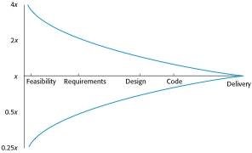
Estimate uncertainty

Slide 35
Key parameters – COCOMO Model
Effort: Amount of labor that will be required to complete a task. It is measured in person-months units.
Schedule: Simply means the amount of time required for the completion of the job, which is, of course, proportional to the effort put. It is measured in the units of time such as weeks, months.

Slide 36
Types of software projects
Organic
Semi-detached
Embedded

Slide 37
Types of software projects
Organic – A software project is said to be an organic type if the
team size required is adequately small,
the problem is well understood and
has been solved in the past and
also the team members have a nominal experience regarding the problem.

Slide 38
Types of software projects
Semi-detached – A software project is said to be a Semi-detached type if the vital characteristics such as team-size, experience, knowledge of the various programming environment lie in between that of organic and Embedded. The projects classified as Semi-Detached are comparatively less familiar and difficult to develop compared to the organic ones and require more experience and better guidance and creativity. Eg: Compilers or different Embedded Systems can be considered of Semi-Detached type.

Slide 39
Types of software projects
Embedded – A software project with requiring the highest level of complexity, creativity, and experience requirement fall under this category. Such software requires a larger team size than the other two models and also the developers need to be sufficiently experienced and creative to develop such complex models.

Slide 40
Types of Models
These are types of COCOMO model:
Basic COCOMO Model
Intermediate COCOMO Model
Detailed COCOMO Model

Slide 41
Basic COCOMO
can be used for quick and slightly rough calculations of Software Costs. Its accuracy is somewhat restricted due to the absence of sufficient factor considerations.
E = A ∗ Size^{B} Note: E=Effort in staff months
Size= KLOC
SOFTWARE PROJECTS | A | B
Organic | 2.4 | 1.05
Semi Detached | 3.0 | 1.12
Embedded | 3.6 | 1.20

Slide 42
The Modes
Organic
2-50 KLOC, small, stable, little innovation
Semi-detached
50-300 KLOC, medium-sized, average abilities, medium time-constraints
Embedded
> 300 KLOC, large project team, complex, innovative, severe constraints

Slide 43
Example
Suppose size is 200 KLOC,
Organic
2.4(200)^{1.05} = 626 staff-months
Semi-Detached
3.0(200)^{1.12} = 1,133 staff-months
Embedded
3.6(200)^{1.20} = 2,077 staff-months

Slide 44
Project Duration
TDEV = c ( E ) ^{d}
Where
TDEV is time for development
c and d are constants to be determined
E is the effort

Slide 45
Constants for TDEV
Mode | c | d
Organic | 2.5 | 0.38
Semi-detached | 2.5 | 0.35
Embedded | 2.5 | 0.32

Slide 46
Example
Picking up from the last example,
Organic
E = 626 staff months
TDEV = 2.5(626)^{0.38} = 29 months
Semi-detached
E = 1,133
TDEV = 2.5(1133)^{0.35} = 29 months
Embedded
E = 2077
TDEV = 2.5(2077)^{0.32} = 29 months

Slide 47
Average Staff Size
E ₌ [staff - months] _{= [staff]}
SS =
TDEV
[months]

Slide 48
Productivity
_{P =} Size ₌
[KLOC]
₌ KLOC
E [staff - months]
staff - month

Slide 49
Complete Example, Organic
Suppose an organic project has 7.5 KLOC,
Effort 2.4(7.5)^{1.05} = 20 staff–months
Development time 2.5(20)^{0.38} = 8 months
Average staff 20 / 8 = 2.5 staff
Productivity 7,500 LOC / 20 staff-months = 375 LOC / staff-month

Slide 50
Complete Example, Embedded
Suppose an embedded project has 50 KLOC,
Effort 3.6(50)^{1.20} = 394 staff–months
Development time 2.5(394)^{0.32} = 17 months
Average staff 394 / 17 = 23 staff
Productivity 50,000 LOC / 394 staff-months
= 127 LOC / staff-month

Slide 51
Comparison for 50 KLOC
Item | Organic | Embedded
Effort (staff- months) | 20 | 394
Development Time | 8 | 17
Average Staff | 2.5 | 23
Productivity | 375 | 127

Slide 52
Intermediate COCOMO
₎ b
E = a ( KLOC × C
Where
E is the effort
a and b are constants (as before)
KLOC is thousands of lines of code
C is the effort adjustment factor
New

Slide 53
Cost Drivers
Intermediate COCOMO introduces Cost Drivers
They are used because
they are statistically significant to the cost of the project; and
they are not correlated to the project size (KLOC).

Slide 54
Categories
I. Product Attributes
II. Computer Attributes
III. Personnel Attributes
IV. Project Attributes

Slide 55
I. Product Attributes
RELY - Required Software Reliability
DATA - Data Base Size
CPLX - Product Complexity

Slide 56
II. Computer Attributes
TIME - Execution Time Constraint
STOR - Main Storage Constraint
VIRT - Virtual Machine Volatility¹
TURN - Computer Turnaround Time
¹The hardware and software in combination.

Slide 57
III. Personnel Attributes
ACAP - Analyst Capability
AEXP - Application Experience
PCAP - Programming Capability
VEXP - Virtual Machine Experience¹
LEXP - Programming Language Experience
¹The hardware and software in combination.

Slide 58
IV. Project Attributes
MODP - Modern Programming Practices
TOOL - Use of Software Tools
SCED - Required Development Schedule

Slide 59
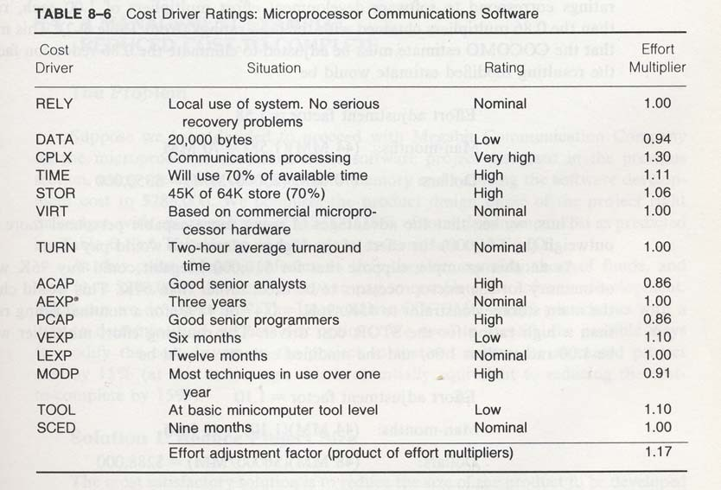
Example
Suppose the following assumptions are made:
1.17

Slide 60
Example ..2
So, the nominal amount of staff-months will be increased by 17% for organic, semi- detached, or embedded projects.
Suppose it is estimated that a project will take 51 nominal staff-months at $5,000 / staff-month.
The cost:
Nominally, $255,000 (51 X $5,000)
Adjusted, $298,350 (51 X $5,000 X 1.17)

Slide 61
Detailed COCOMO
additionally accounts for the influence of individual project phases, i.e in case of Detailed it accounts for both these cost drivers and also calculations are performed phase
The Six phases of detailed COCOMO are:
Planning and requirements
System design
Detailed design
Module code and test
Integration and test
Cost Constructive model

Slide 62
COCOMO - Advantages
Based on history
Repeatable
Unique adjustment factors
Has different modes
Works well on similar projects
Highly calibrated
Well-documented
Easy to use

Slide 63
COCOMO - Limitations
Ignores requirements volatility
Ignores documentation
Ignores customer’s “skill”
Oversimplifies security
Ignores software safety
Ignores personnel turnover
Ignores many hardware issues
Personnel experience may be obsolete
Must know the cost drivers
Must be able to predict project size

Slide 64
Final Word
“The models are just there to help, not to make the management decisions for you.”
-- Barry Boehm

Slide 65
Key points
Estimation techniques for software may be experience-based, where managers judge the effort required, or algorithmic, where the effort required is computed from other estimated project parameters.
The COCOMO costing model is an algorithmic cost model that uses project, product, hardware and personnel attributes as well as product size and complexity attributes to derive a cost estimate.

